Slide 1

Wallin Education Partners
2-Year Scholarship Application Cycle
2024
2
Year
Year
Notes:
Hello! And welcome to this information session about the Wallin Education Scholarship.
I’m _______, a current Wallin Employee, here to talk to you about this incredible opportunity.

Slide 2
Agenda
Brief Intro What is Wallin Education Partners?
Eligibility Who can apply?
Application Experience What’s the application like?
Questions
2024 2-Year Wallin Scholarship

Slide 3



What is Wallin Education Partners?
2
Year
  Aid
  Advising
  Access
  Scholarship to use toward college tuition
  Professional advisors
  College-to-Career
  opportunities
2024 2-Year Wallin Scholarship
Notes:
So, what is the Wallin Scholarship?
It’s a renewable scholarship that pairs financial aid with advising and career prep opportunities. Basically, the program offers up to $16,000 to help you fund your bachelors degree. This isn’t a small amount of money and you can count on it for each of your four years in college.
The money’s great but what really makes Wallin special is that the scholarship pairs scholars with an advisor who is your go to on everything from how to deal with a bad roommate to how to juggle all your classes and activities, to where to find research and internships so you can maximize your college experience. Think of it as your one stop shop to getting the answers you need to be as successful as possible in college.
Beyond the money and the advising, Wallin Scholars have access to some awesome career prep opportunities. Each year Wallin Scholars have access to a huge variety of opportunities to explore their career via Lunch and Learns featuring panelists from all kinds of different industries or accessing the the Wallin Wisdom project that pairs Wallin Scholars with professionals in their industry of choice. Scholars have opportunities to build career skills such as networking, resume building, interviewing and more. Just this fall there was a session on networking in a virtual space. When scholars have their skills honed and their career trajectory set, there are opportunities for Scholars to find jobs through our monthly newsletter or at the Wallin Scholar Career fair.
The scholarship really is meant to support you with opportunities and guidance from the day you leave high school to the day you graduate college.

Slide 4

What is Wallin Education Partners?
2
Year
  Retention
>90%
retention compared to our college partner average of 54%
2024 2-Year Wallin Scholarship
Notes:
And, it works!
Nearly 90% of Wallin Scholars graduate high school, far higher than the national rate of 63%. Just as importantly, 40% graduate without any debt at all. Quite an accomplishment in this day and age. On average Wallin Scholars have a very manageable $10,000 of debt when they graduate. And all that career prep seems to work as 95% of our scholars either enter the workforce or go right to graduate school after earning their bachelor degree.
I’m telling you, this is an opportunity you don’t want to miss.

Slide 5
Agenda
Brief Intro What is Wallin? ?
Eligibility Who can apply?
Application Experience What’s the application like?
Questions
2024 2-Year Wallin Scholarship
Notes:
Now you know what the Wallin Scholarship is. Let’s talk about who can apply.

Slide 6


Who Can Apply?
2
Year
Graduating seniors (class of 2024) who attend a partner high school
Students with a minimum 2.0 GPA (unweighted)
Students who demonstrate financial need
Students who plan to start college full-time in Fall 2024 at a partner 2-year
college.
Aspire and Mortenson
Opportunity Pathways
2024 2-Year Wallin Scholarship
Notes:
To apply, you need to meet the following criteria.
One. You need to attend one of our 58 partner high schools. We partner with high schools in the Twin Cities and surrounding metro area so students who aren’t attending one of our partner schools sadly will not be considered for the Wallin Scholarship. If you aren’t sure you can find the full list on our website underneath the Apply tab.
Two. You need to have a minimum 3.0 unweighted GPA. We’ll ask for this information during the application and for final transcripts after you graduate.
Three. You need to have some financial need. Wallin Education Partners uses Adjusted Gross income to determine this. I’ll come back to this in a second.
Four. You need to start college in the Fall of 2021 in the 5 state area or at any Historically Black College or University. If you’re thinking of applying to colleges outside this area, say…Illinois, that’s ok! Wallin Education partners selects and notifies it’s new scholars in April each year so you should know whether or not you’re a Wallin Scholar ahead of your final college choice so you can make an informed decision about where to attend college.

Slide 7
Financial Need
Eligibility Grid (2023-24)
Household Size | Adjusted Gross Income Not to Exceed
1-5 People | $95,000
6 or more | $135,000
2024 2-Year Wallin Scholarship
Notes:
Now, as for financial eligibility. When you file your FAFSA or Minnesota Dream Act, you’ll be asked to provide your families Adjusted Gross Income as a part of those forms. To be eligible for the Wallin Scholarship your family needs to meet the requirements on this chart. Basically, if you live with up to 5 family members, your Adjusted Gross Income should be less than $81,500. If you have more folks in your family, that number goes up a little bit.
If you aren’t sure…APPLY! Wallin will look at every application that comes in and decide about eligibility. If your family has had a year that looks different than normal, you’ll have a spot to tell us about it as well on the Financial Page of the application.

Slide 8
Agenda
2
Year
Brief Intro What is Wallin? ?
Minimum Eligibility Who can apply?
Application Experience What’s the application like?
Questions
2024 2-Year Wallin Scholarship

Slide 9
What’s the Application Like?
2
Year
The 2-year application is a 2 step process: submit your app and submit transcript
If you already submitted a 4-Year app, most of your information will transfer over.
The application will ask you information about:
Personal Info
Demographics
High School Info (transcript)
Pathway Interest
College Interest
Activities/Personal Projects
Employment
Family Responsibilities
Essays
Financial Info
2024 2-Year Wallin Scholarship

Slide 10
What’s the Application Like?
2
Year
Application Opens
March 1st, 2024
Mortenson Deadline April 15th, 2024
Priority Deadline!
May 15th, 2024
Scholar Night!
June 11th, 2024
The 2-year selection process is rolling, meaning
the sooner you apply, the better chance you have to be selected!
2024 2-Year Wallin Scholarship
Notes:
The application runs from November 1st to February 1st of 2021. Apply early to get support through the application and ensure you complete everything on time!
We notify everyone of our decisions in mid-April so you know whether or not you are a Wallin Scholar before you need to make a college decision. We have about 300 scholarships and have just about 700 applicants each year. We could have fewer this year so it’s definitely worth submitting your app!

Slide 11

What’s the Application Like?
Go to Wallin website
Click on Apply
and select
2-Year Program
2024 2-Year Wallin Scholarship
Notes:
You’ll find the application at www.wallinpartners.org. Open up a browser on your phone, tablet or computer and navigate there. From the webpage, you’ll see the word Apply in the upper right corner. Click 4-year program to get started.

Slide 12
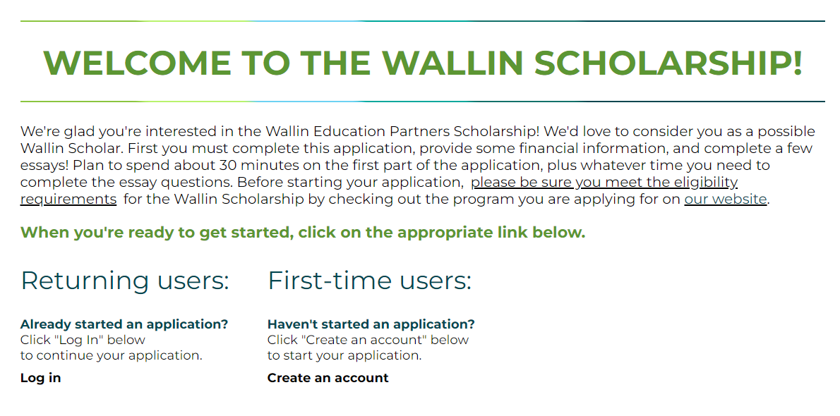
What’s the Application Like?
2024 2-Year Wallin Scholarship
Notes:
Once you log on, you’ll see this page, where you can begin your application. If you ever start an application, but don’t finish it, it’ll show up on this page too.

Slide 13
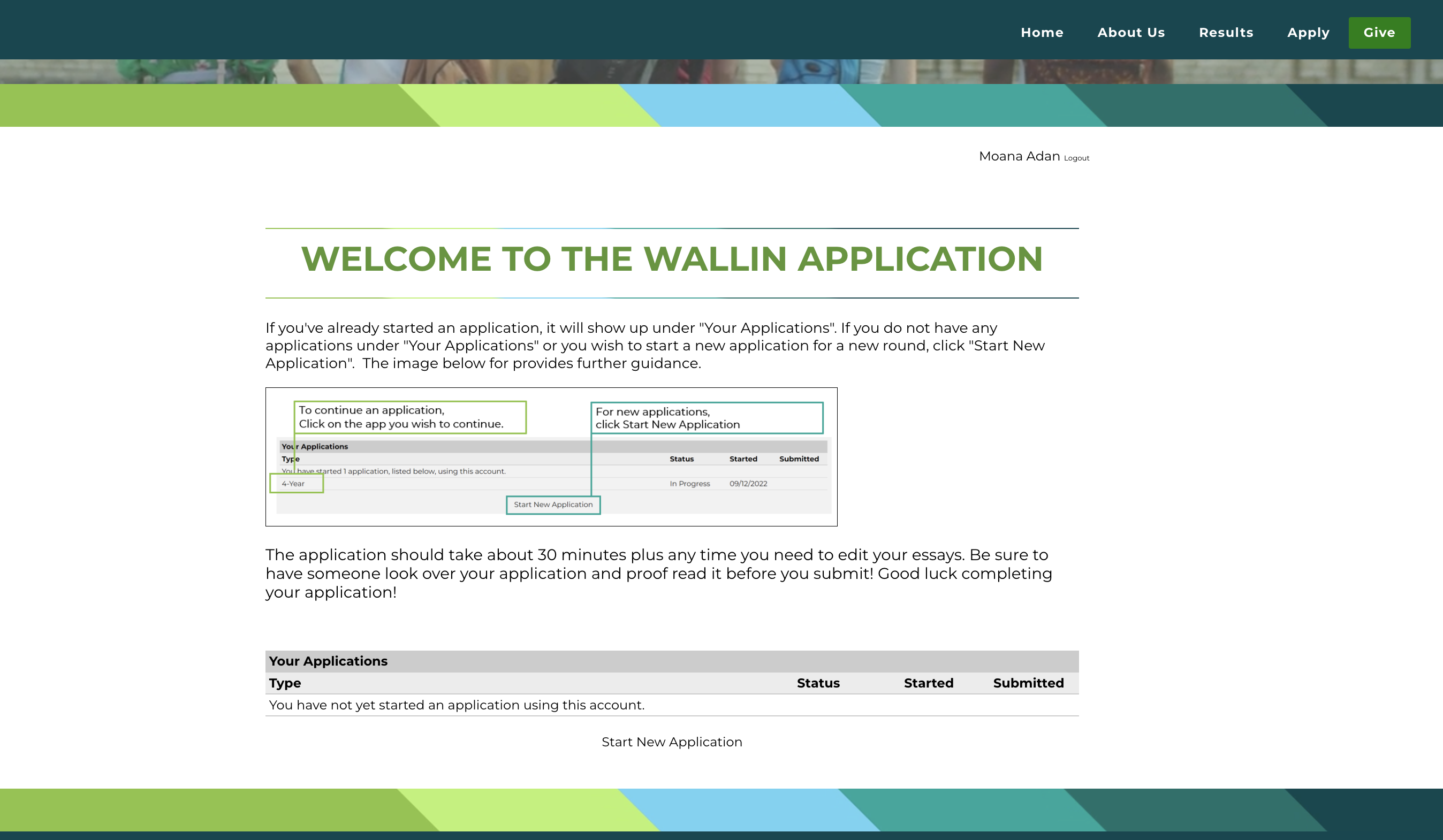
What’s the Application Like?
2023 2-Year Wallin Scholarship
Notes:
Once you log on, you’ll see this page, where you can begin your application. If you ever start an application, but don’t finish it, it’ll show up on this page too.

Slide 14
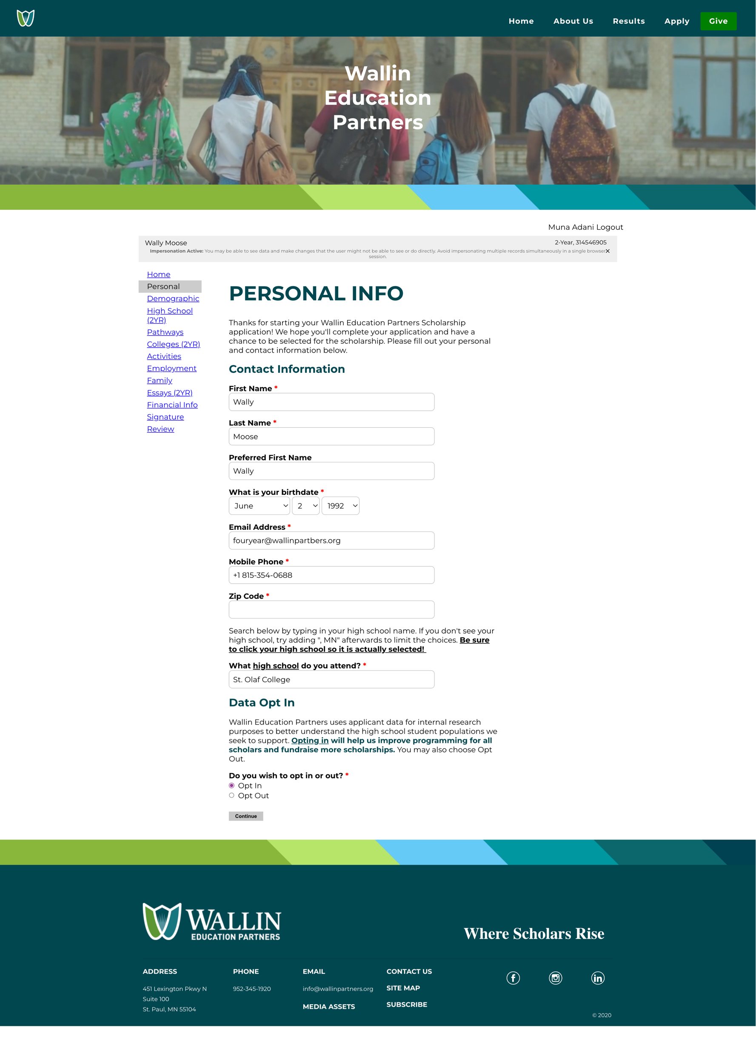
What’s the Application Like?
The 2-year application has 10 sections you need to complete.
2024 2-Year Wallin Scholarship
Notes:
The application will consist of 10 sections, as well as signature and review pages. This may feel daunting, but the first five sections will only take you 10-15 mins to complete. And if you have created a resume in the past, we encourage you to have it open when working on your application. It’ll make it much easier to fill out the activities, employment, and work sections.

Slide 15
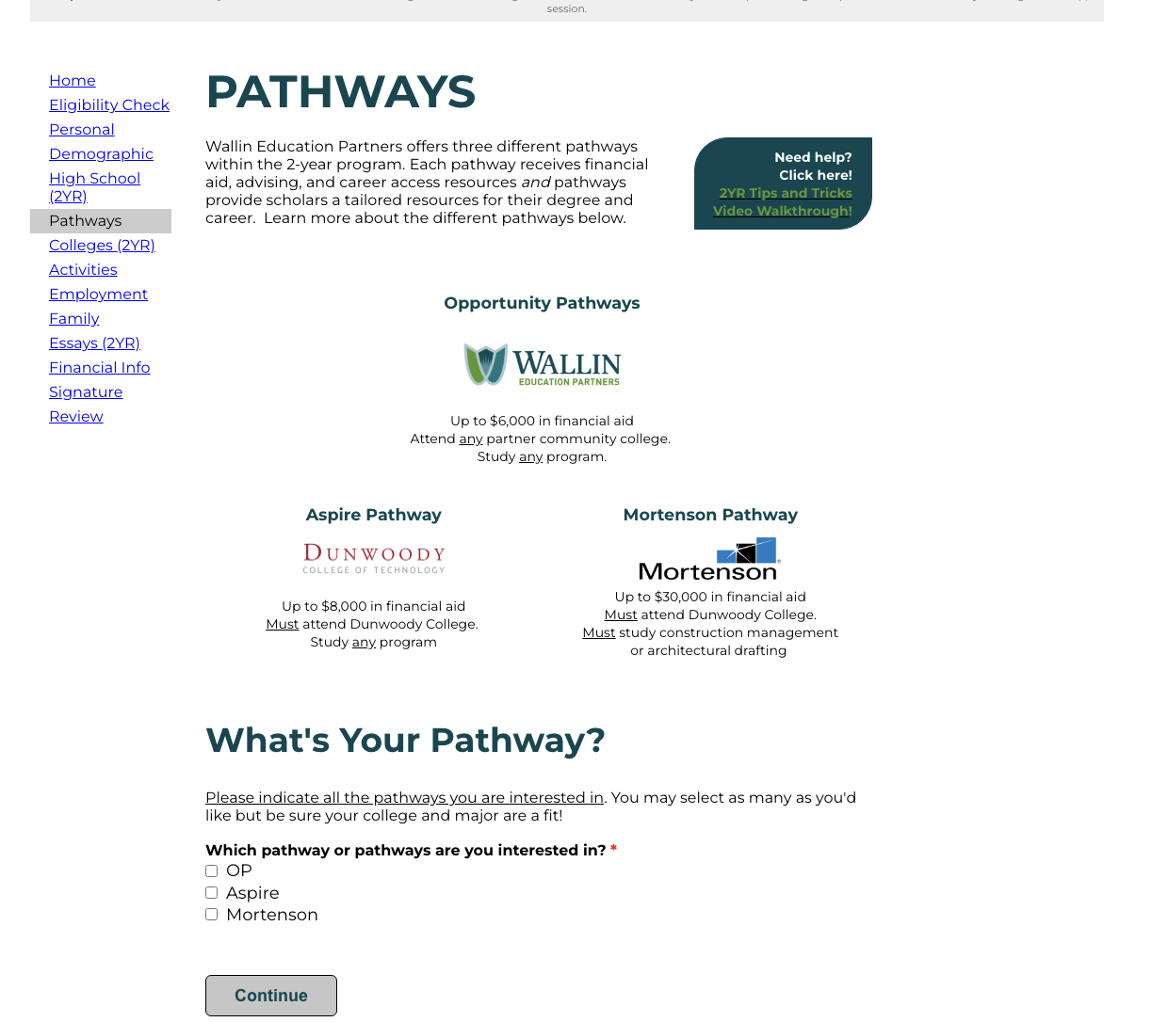
Pathways
2
Year
2024 2-Year Wallin Scholarship

Slide 16
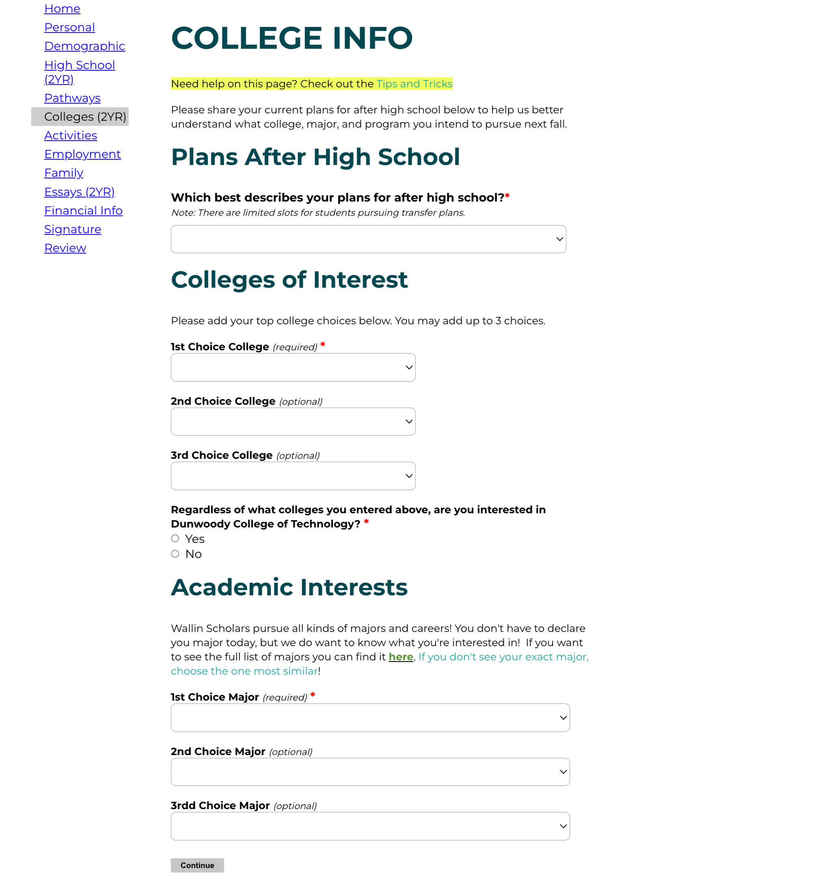
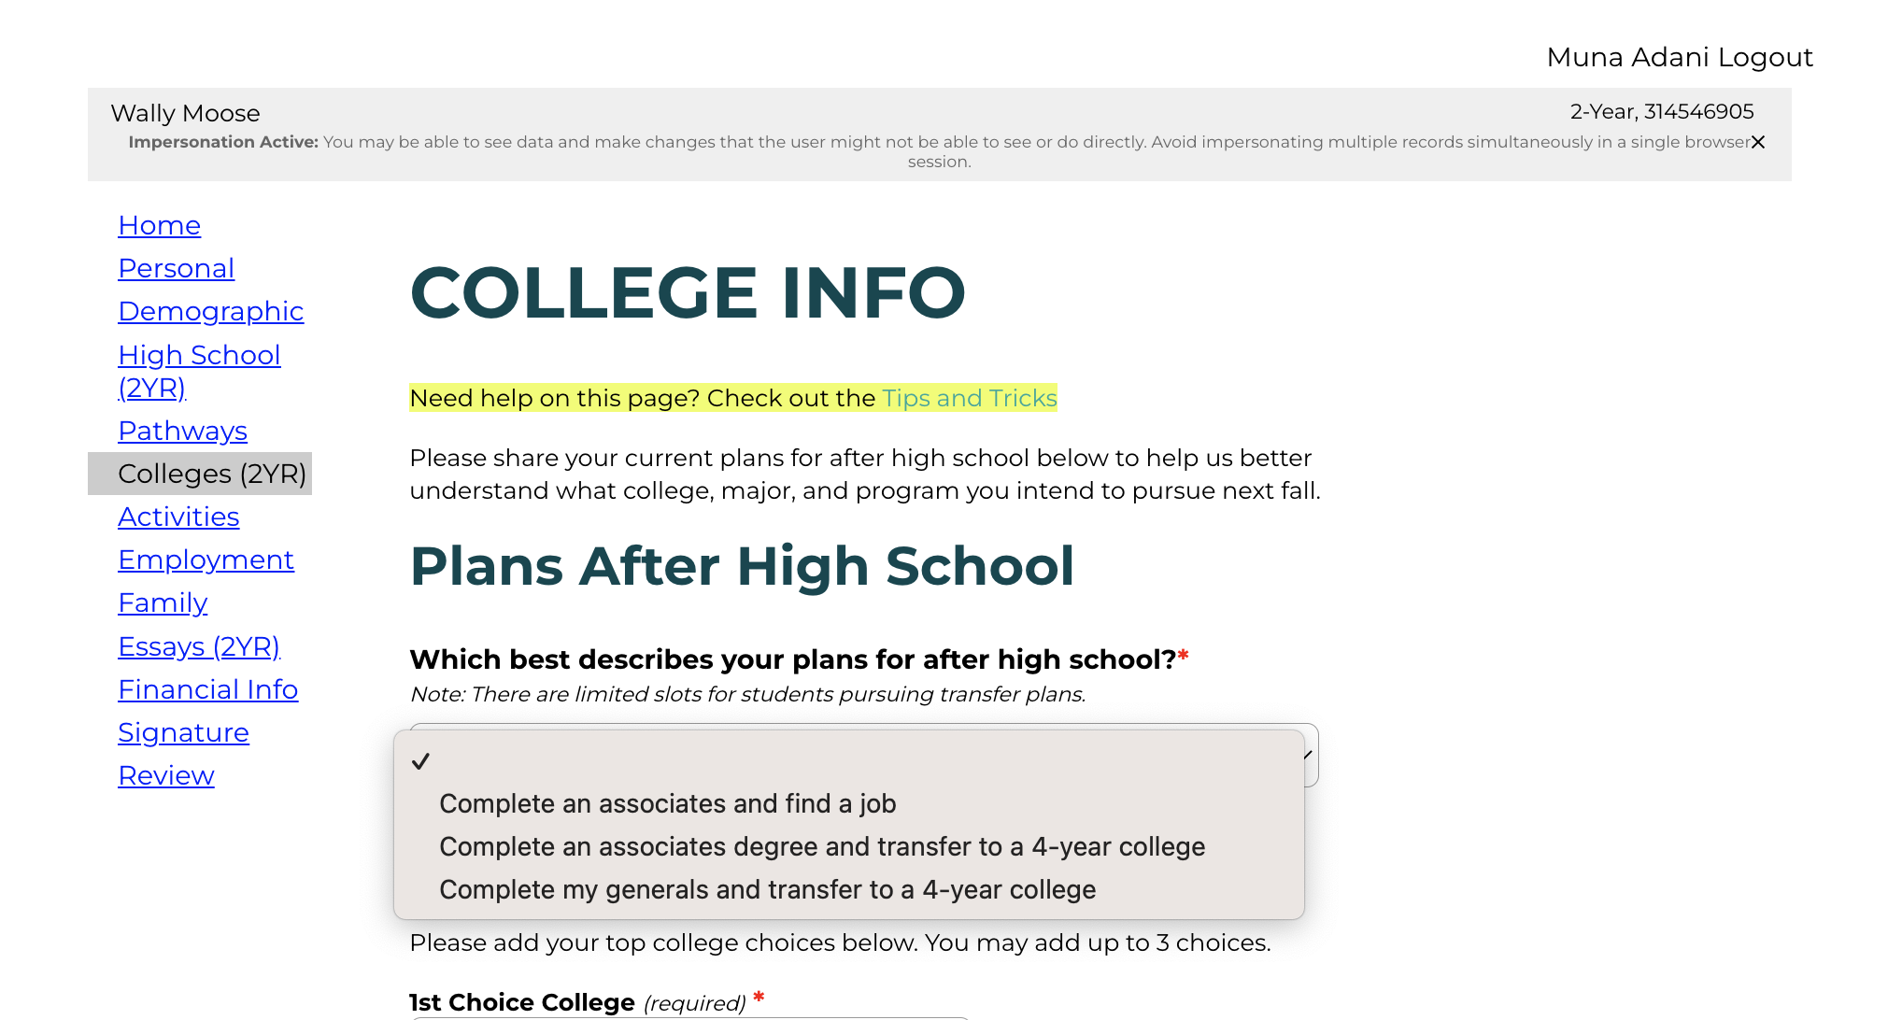
College Info
2
Year
2024 2-Year Wallin Scholarship
Notes:
This year we’ll ask students two write three essays, one from the list of common app prompts and two about how they view themselves. You can see the list of questions here. A good tip is to use most of the words your allowed! Essays are the best place for application readers to get to know you so take your time on them and have someone double check them before you submit.

Slide 17
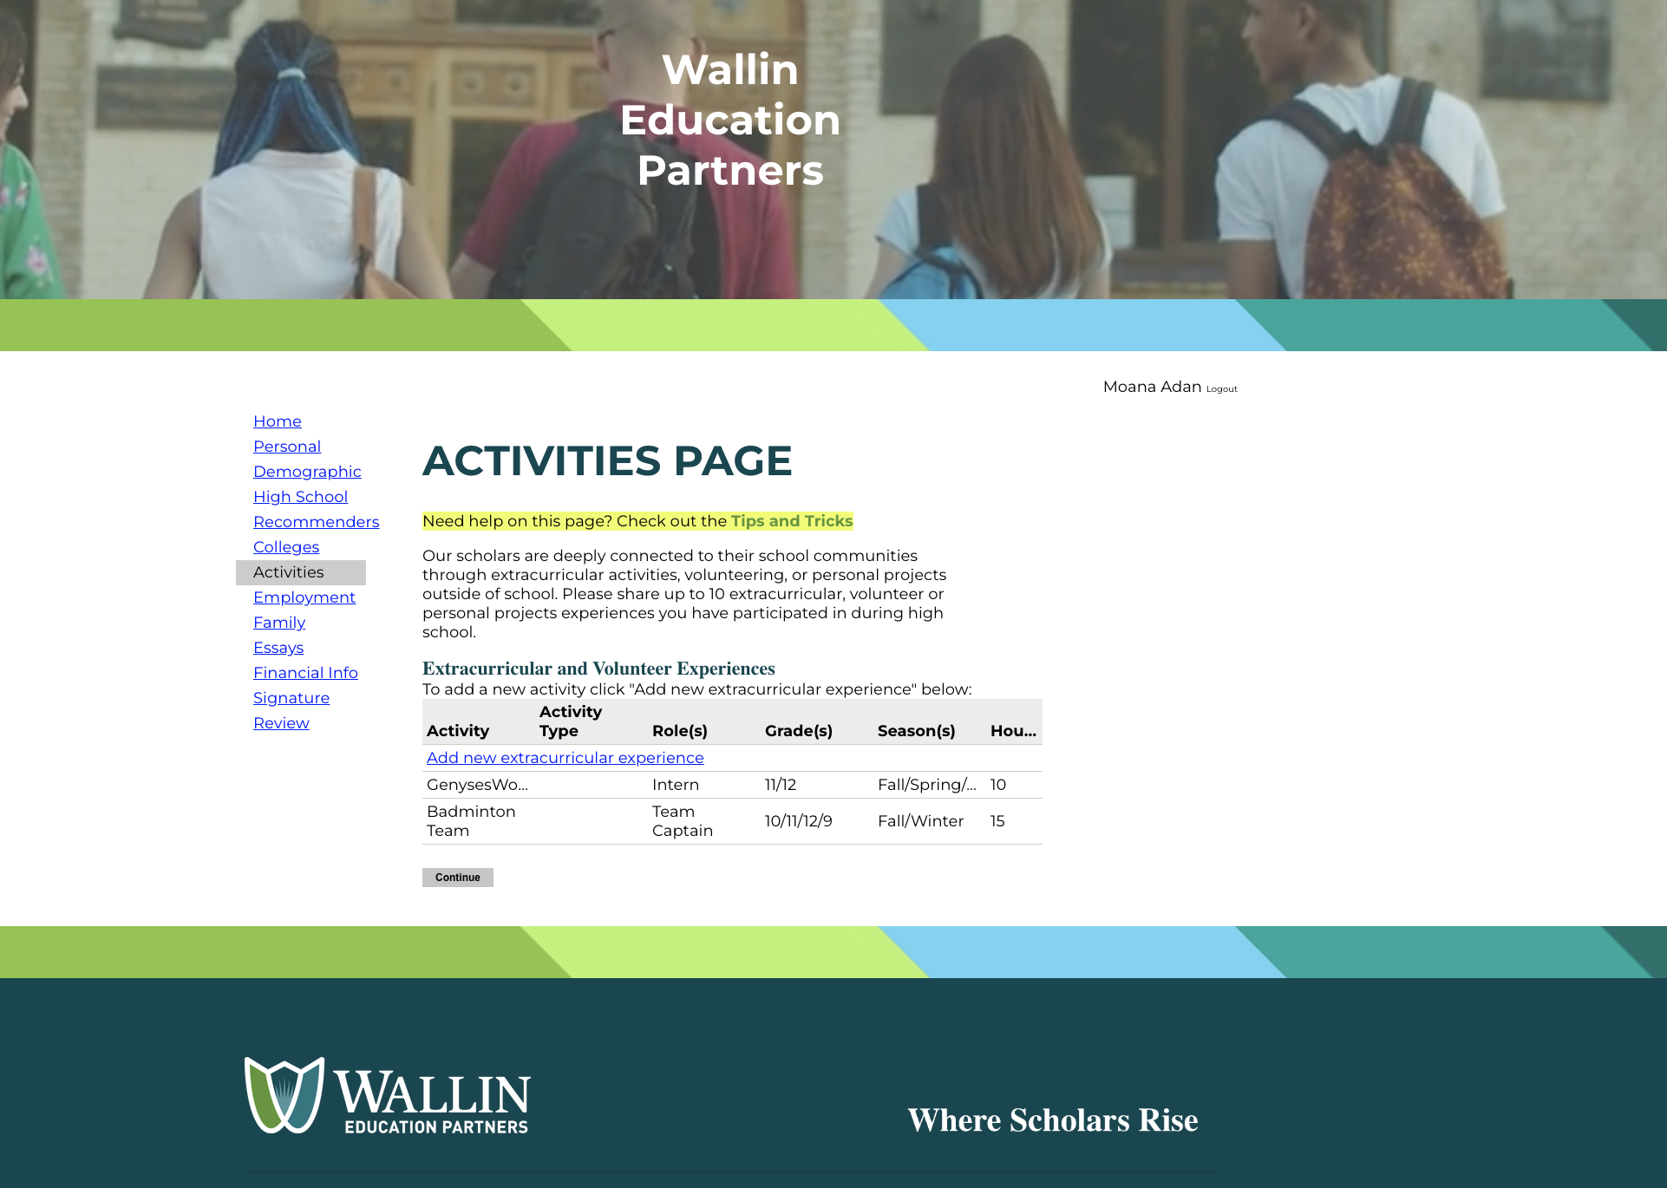
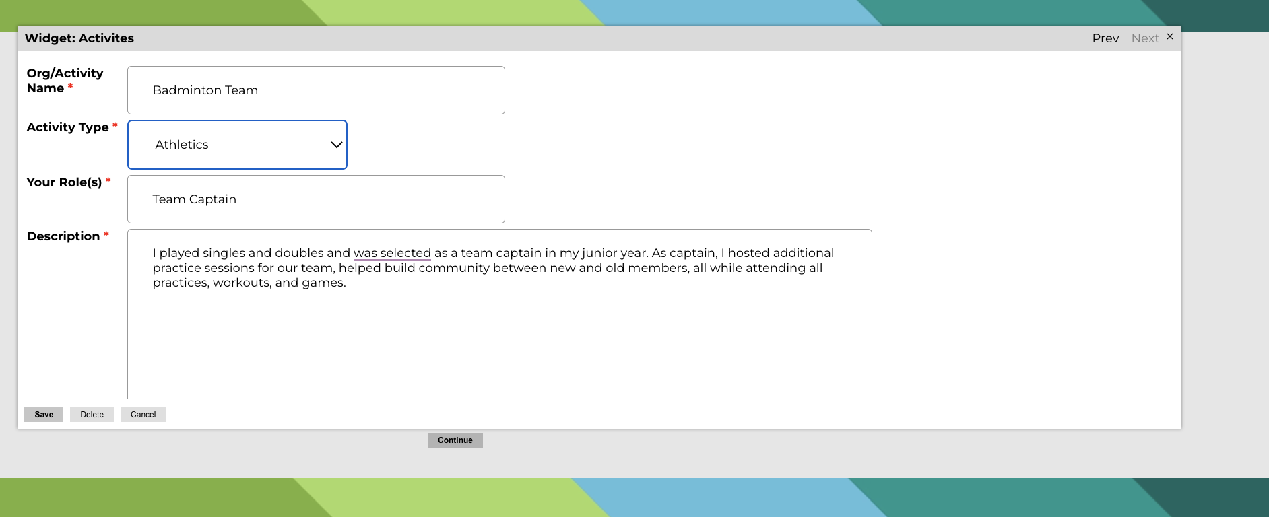
Involvement Section: Activities, Employment, Family
2024 4-Year Wallin Scholarship
Notes:
The activities, employment, and family responsibilities sections will all look similar. We’ll ask to name the experience, indicate the type from a drop-down list, describe your role and what you did, and how much time each week you engaged in that specific activitity. There is also space to indicate any honors, awards, or achievements.
Our biggest advice is for you to be as descriptive as possible!

Slide 18
Essay Section
2
Year
This year Wallin is asking for two essays.
Essay #1: Tell us about your academic interests and goals for the future. * (500 words)
What specific subject or career path do you hope to explore or study in college? If you're undecided, what paths are you most curious about?
What are your current career goals?
How will attending the community college of your choice help you achieve your career goals?
What other personal and professional goals do you have for the next 5-years?
Essay #2: How will your Wallin Advisor help you achieve your academic and career goals? * (250 words)
What are two or three academic or career goals you hope to work on with your Scholar Advisor?
How will meeting regularly with your Wallin Scholar Advisor help you meet those goals?
Tell us about your academic experience during high school. What should your Wallin advisor know about you to best help you meet your academic and career goals?
Students interested in Dunwoody will additionally share briefly about their interest.
2024 2-Year Wallin Scholarship
Notes:
This year we’ll ask students two write three essays, one from the list of common app prompts and two about how they view themselves. You can see the list of questions here. A good tip is to use most of the words your allowed! Essays are the best place for application readers to get to know you so take your time on them and have someone double check them before you submit.

Slide 19
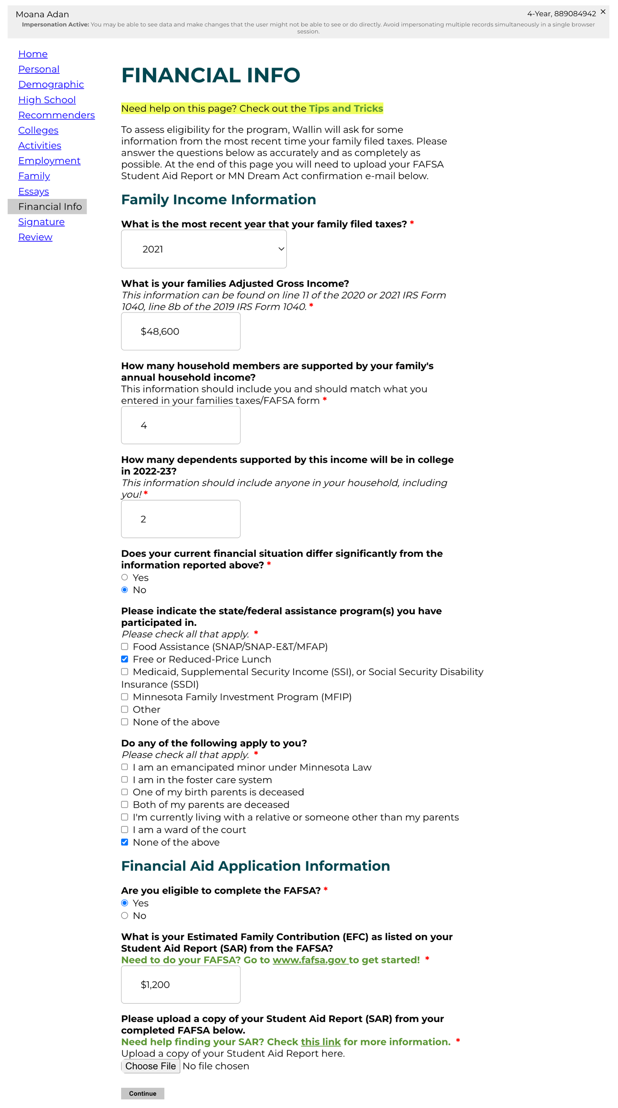
Financial Aid
Family Income
Details
Make sure you have a copy of your parent’s 2022 1040 tax form
Financial Aid
Application Details
2024 2-Year Wallin Scholarship
Notes:
After completing your essays, you’ll work enter financial information. Many of the questions we’ll ask will be like what you’re asked on the FAFSA and MN Dream Act. Be sure to answer all the listed questions and upload either your Student Aid Report from the FAFSA or a screenshot of your MN Dream Act confirmation

Slide 20
Application Advice
Give yourself enough time to craft a strong application. It takes time to write strong essays, outline your extracurriculars, and communicate your academic and career goals—so start the app early and work on your over several days/weeks!
Read the questions carefully & answer thoroughly and thoughtfully. We want to get to know you so make sure that your personality & experiences shine through.
We want you to be successful and put in a lot of time and effort to help you navigate this application—so please use the Tips and Tricks document & video walkthroughs if you’re stuck or have questions!
Get feedback! Your teachers, friends, family members, counselors, and mentors want you to succeed so use them. Ask for their help with reviewing your essays!
Stay organized: Keep track of the Wallin EP scholarship deadline and make sure your financial aid applications are completed before submitting!
2024 2-Year Wallin Scholarship
Notes:
We want you to be successful applicants for Wallin as well as any other scholarships you apply for, so we encourage you to keep the following pieces of advice in mind when working on your application

Slide 21
Interested? Begin your 2-Year App Today
2
Year
Learn about our two-year programs by going on our website: https://www.wallinpartners.org/2-year-program.html
2024 2-Year Wallin Scholarship
Notes:
The application runs from November 1st to February 1st of 2021. Apply early to get support through the application and ensure you complete everything on time!
We notify everyone of our decisions in mid-April so you know whether or not you are a Wallin Scholar before you need to make a college decision. We have about 300 scholarships and have just about 700 applicants each year. We could have fewer this year so it’s definitely worth submitting your app!

Slide 22

QUESTIONS?
Thank You!

