Slide 1
2023-2024 Scholarship Information Session
Where Scholars Rise

Slide 2
Agenda
Scholarship
Advising
Career
Eligibility Criteria
Application Process
Deadlines
NEXT sTEPS
Mission & Vision
Notes:
M into

Slide 3
Mission & Vision
Outcome Data
6,500+ Wallin Scholars in 31 Years
89% of our scholars graduate college within 6 years compared to 52.3% for the state of MN
Alumni
30% of Wallin Scholars graduated debt free
98% of our alumni are currently employed or in a graduate program
30% are getting advanced degrees
Mission & Vision
Started in 1992 by Win & Maxine Wallin with the goal of supporting motivated high school seniors in getting to and through college through funding, advising, and career support
Currently recruit from 73 high schools in MN and have students who go to 70+ college in the Midwest and 20 HBCUs

Slide 4
One Program…Multiple Pathways
2-Year Program
4-Year Program
Opportunity Pathway
Aspire Pathway
Flagship 4-Year Pathway
HealthPartners Pathway
Mortenson Pathway

Slide 5
Core Values
Our Approach
Scholar-Centered, Collaboration, Equity, Trust, and Innovation
Aid
Advising
Access

Slide 6
Aid
Scholarship to use toward college degrees
Up to $16,000 over four years for 4-Year Colleges and Universities
Up to $6,000 over 3 years for 2-Year Community Colleges
$8,000 for students attending Dunwoody & up to $30,000 over 2 years for Mortenson Scholars at Dunwoody
What can my scholarship funding cover?
The Wallin Scholarship can be used to cover up to a student’s cost of attendance—which is the total amount it costs a student to attend college.
Tuition and Fees
Books , Course Material, Equipment
Transportation (Bus Passes/Parking)
Laptops
Study Abroad
Housing and Food

Slide 7
4 Year Premier College Partners
Making College More Affordable
Personal
Support
Beloit College:
Private, four-year college
Rock County, Wisconsin
(5 hrs from Twin Cities)
Class size: 1,011
Grad rate: ~80%
Giving an extra $2K per year
Cornell College:
Private, four-year college
Mount Vernon, Iowa
(4.5 hrs from Twin Cities)
Class size: 1,045
Grad rate: ~70%
Giving an extra $2K per year
St. Olaf College:
Private, four-year college
In Northfield, MN
(45 min from Twin Cities)
Class size: 3,000 students
Grad rate: ~85%
Giving an extra $1K per year, meets full need.

Slide 8
Advising
1:1 Support from Scholar Advisor
Academic Planning & Career Planning
Encouragement/Support
Connection to Campus Resources
What YOU need/want to talk about
Access to Wallin Moosemail and Scholar Portal
Alumni Engagement/Support
Access to job opportunities
Workshops on finances, professional development
Events, winter social
Opportunity to help with application reading

Slide 9
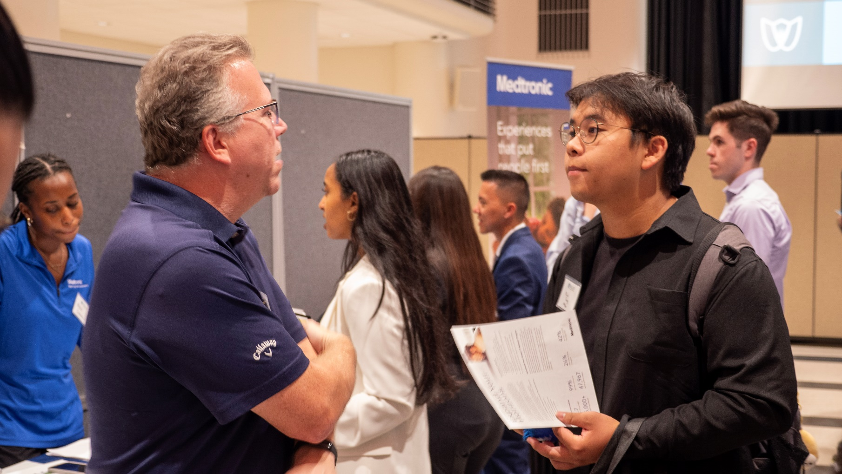
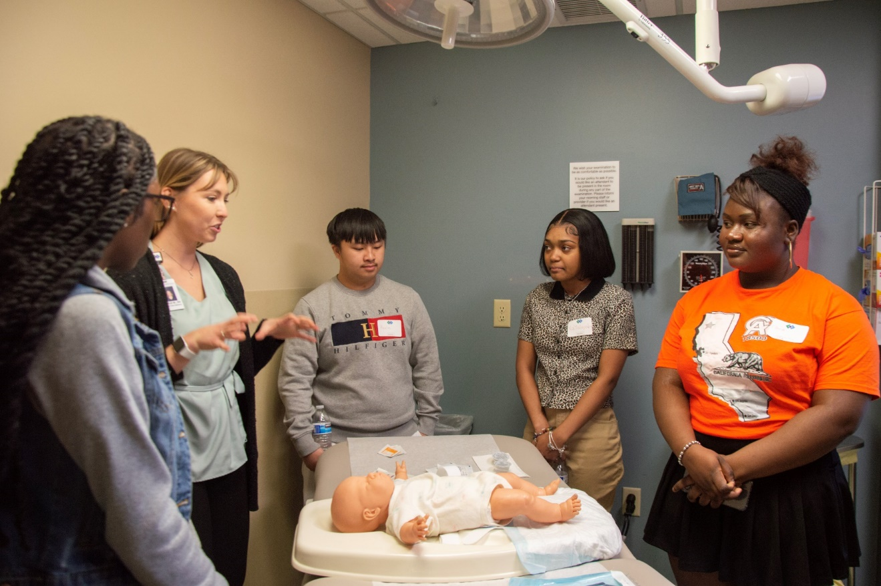
Access
Annual Career Fair
Over 40 employers
Just for Wallin Scholars!
Career Curriculum
Access to career prep
Rise Learning
Interview & Resume Prep
Career Programming
Upturnships
Work readiness program
Starting sophomore year!

Slide 10
Graduating seniors (class of 2024) who attend a partner high school
An unweighted minimum 3.0 GPA (4 Year Program) or 2.0 GPA (2 Year Program)
Must demonstrate financial need based on Adjusted Gross Income (AGI)
A family of 1-5 people = AGIs up to $95k
A family of 6 or more = AGIs up to $135k
2-Year Students must one of attend one of 12 partner community colleges full-time in Fall 2024
4-Year Students must plan to start college full-time in Fall 2024 at a 4-year college or university in: Iowa, Minnesota
North or South Dakota
Wisconsin, or
OR Any Historically Black College or University (HBCU)
Eligibility Criteria

Slide 11
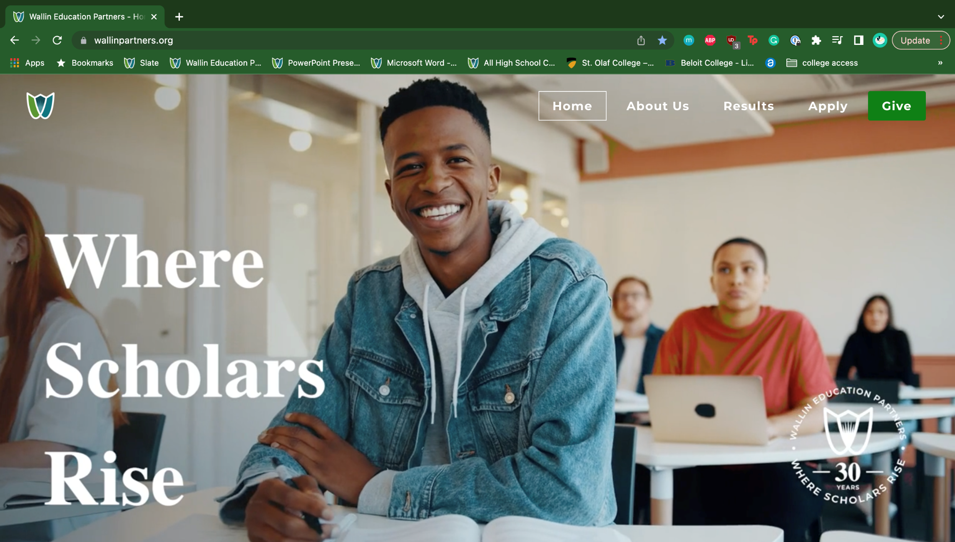
Application Experience
www.wallinpartners.org/apply

Slide 12
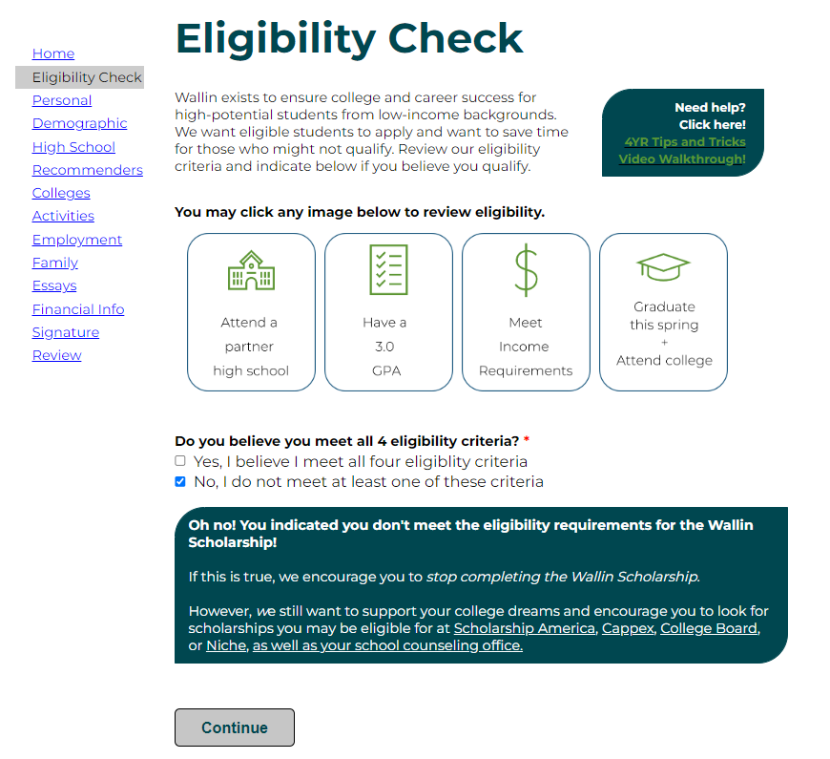
Application Overview
A complete app is:
Submitted to Wallin
Has financial aid documents
Has two submitted recommendations.

Slide 13
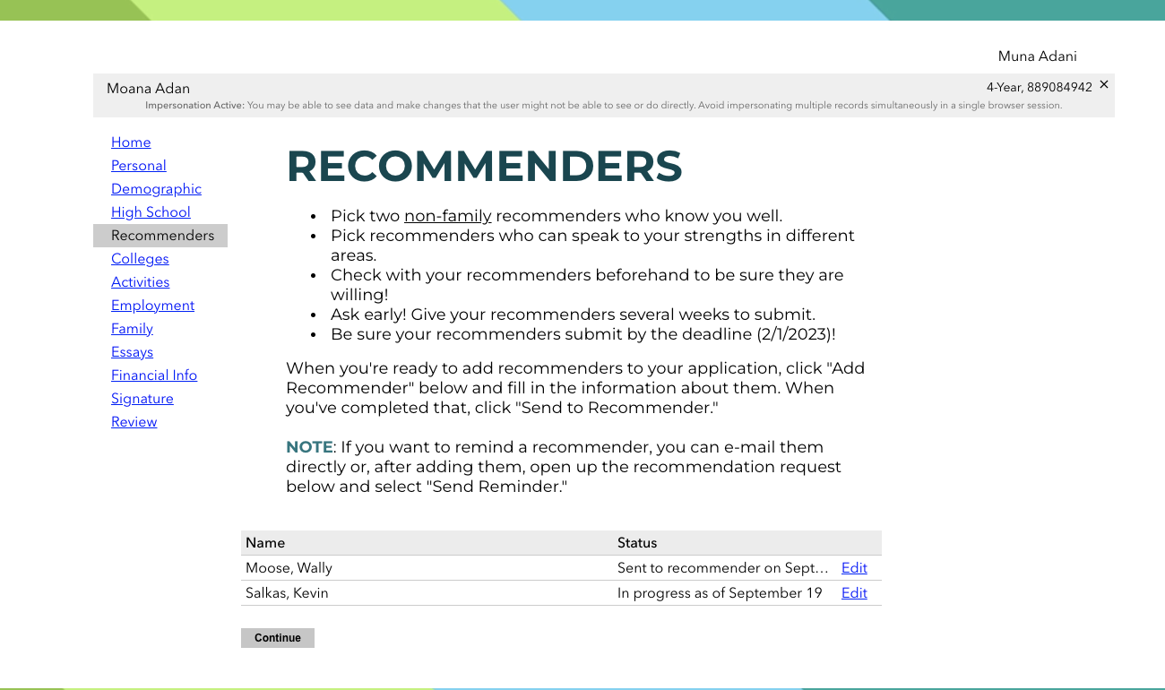
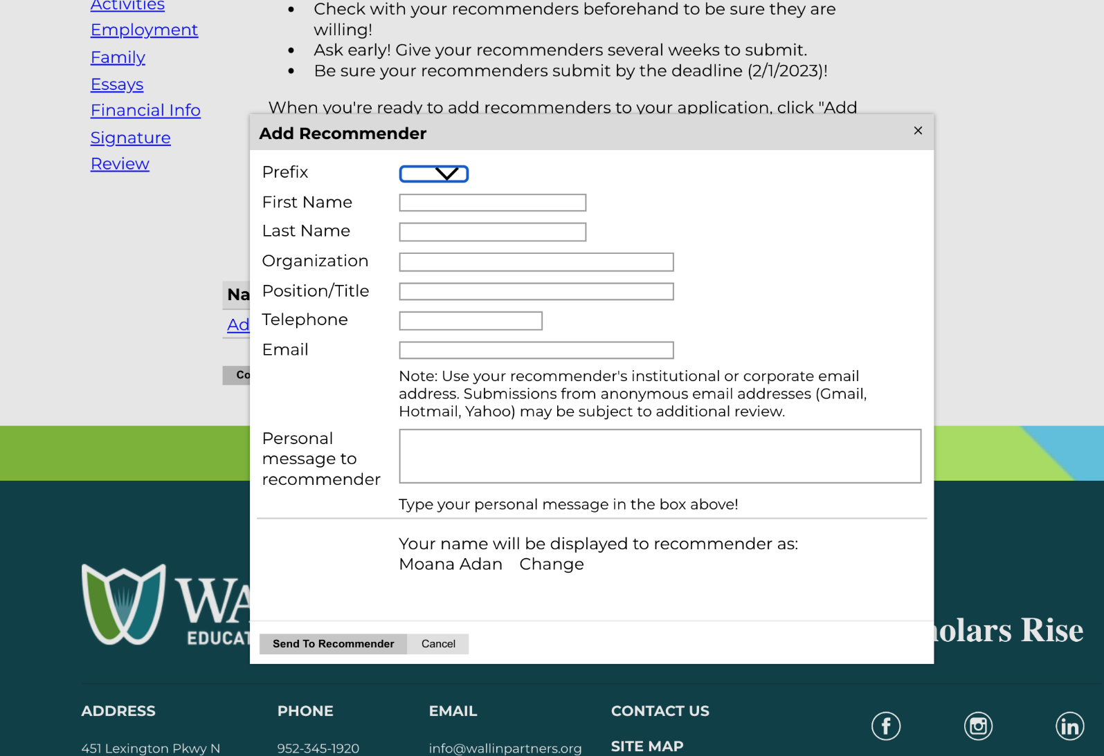
Recommendations
We need 2 non-family recommenders
Pick folks who knows you well & can help the selection committee understand YOU
Give your recommenders enough time (2 weeks!)
Double, triple check email addresses

Slide 14
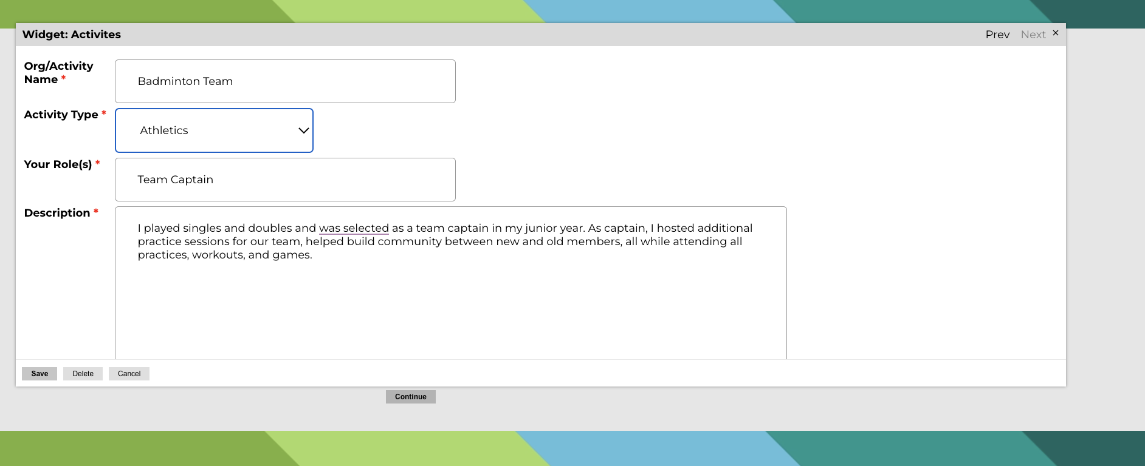
Involvement Section
Opportunity to share your involvement in your school, community, home and work!
Be specific, be descriptive
Be reflective, honest, accurate about weekly hours

Slide 15
Essays Section
We will ask for three essays in the 4-Year application.
Essays are meant to help the reader understand you –take the time to self-reflect and write an essay that conveys who you are, what your passions are, and what you’re hoping to do while in college.
We will provide you with tips and guidance on the Essay Sections but we still encourage you to have 1-2 people read it over and give you feedback!

Slide 16
Essays Prompts (4-Year)
Share a passion, interest, or issue that is important to you.*
Tell us more about this passion, interest, or issue and why it's so important to you.
What skills, experiences, or lessons have you gained because of this passion, interest, or issue?
In what ways has this passion, interest, or issue helped you build community or see yourself as part of a community?
How do you see yourself engaging with this passion, interest, or issue while in college?
Describe a moment during high school when you worked with a teacher, counselor or mentor to overcome an obstacle. *
What was the specific situation that led you to seek out help or support?
When did it become clear that seeking help was the best course of action? What made you come to this realization?
What did you learn from this experience?
How do you think these lessons will shape how you seek help or support in college?
Tell us about your academic interests and vision for your future. *
What specific subject or career path do you hope to explore or study in college? If you're undecided, what paths are you most curious about?
What experience, or experiences, have led you to this subject or career path?
How do you think you'll explore or engage in this academic interest in college?
Where do you see yourself 10 years from now academically and/or professionally?
500 Words
300 Words
300 Words

Slide 17
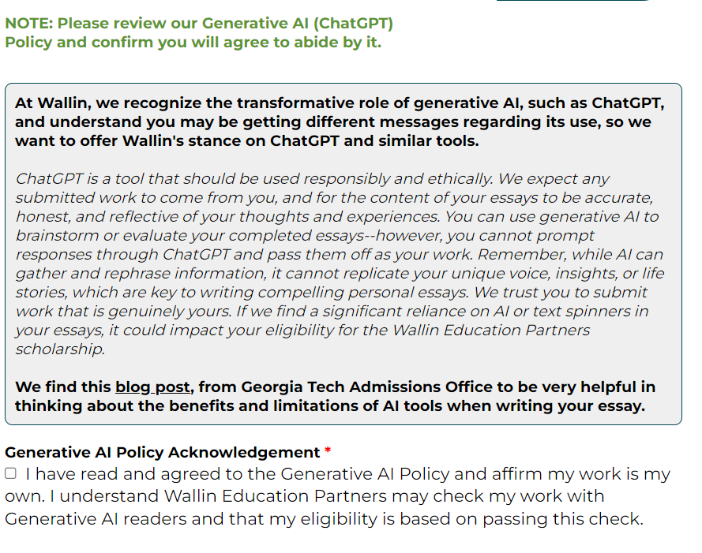
Core Values
What about ChatGPT?
Scholar-Centered, Collaboration, Equity, Trust, and Innovation
Wallin expects your writing to be your own & is training its team on spotting AI-written essays & will do its own checks
AI can be helpful as a tool if used responsibility and ethnically—we’re fine with it being used to brainstorm or edit writing but the actual writing needs to come from you
SP's Approach to Advising
Wallin & SP
Processes

Slide 18
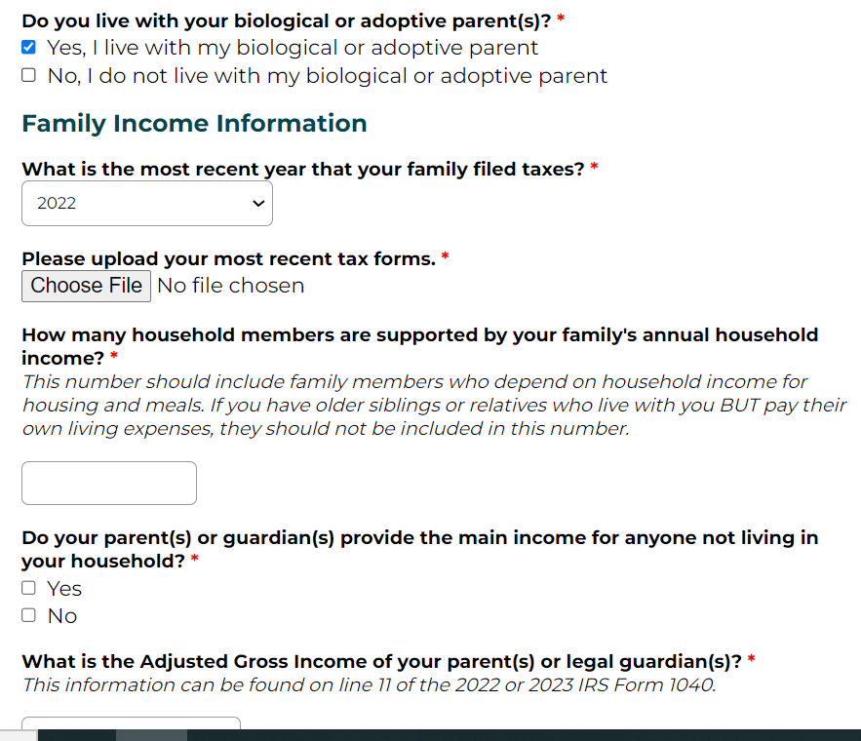
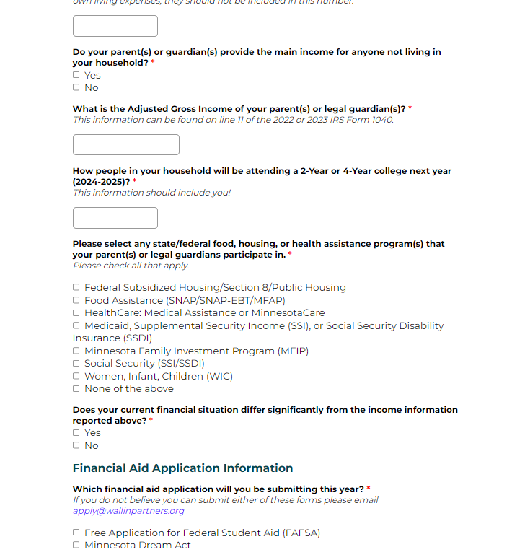
Financial Aid Section
You will likley need help from parent(s) or guardians in this section
If your family filed taxes in past 3 years, we will need copy of 1st page of 1040 tax form to confirm financial need
If you have questions/concerns, email us at apply@wallinpartners.org

Slide 19
Application Timeline
Application Opens November 1st, 2023
Application Closes February 1st, 2024
Scholars Notified!
Early/Mid-April
2-Year Opens
March 1st 2024
2-Year Priority Deadline
May 15th 2024
4-Year Scholars will know if they’ve been selected before they need to choose a college!

Slide 20
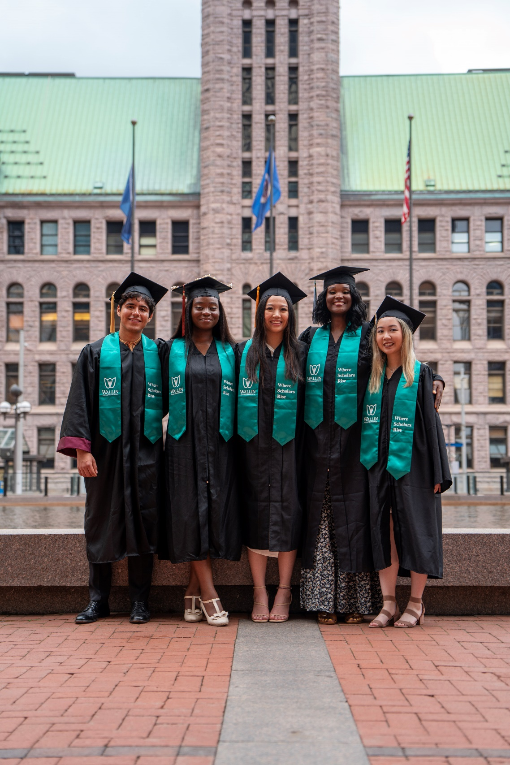
Questions & Next Steps
Next Steps
Start an application at wallinpartners.org/apply
Identify your 2 recommenders
Start thinking about responses to essay prompts
Get your HS transcript (unofficial) and tax form ready
And remember, work on the application over several days/weeks and not in one sitting!!
Good luck! We can’t wait to read your application! Reach out with any questions at apply@wallinpartners.org

